Slide 1
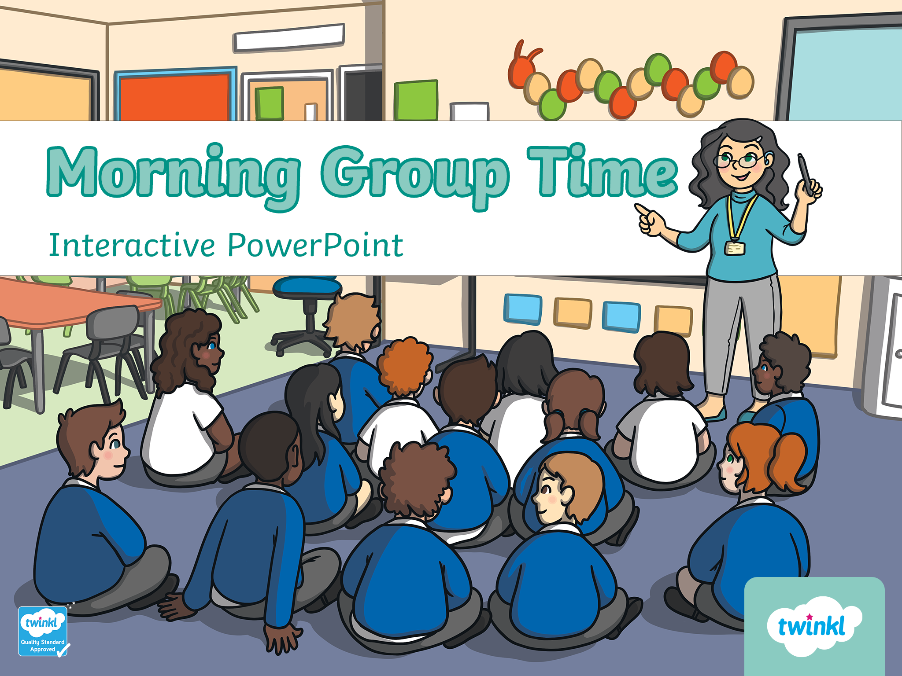

Morning Circle Time
Joeys

Slide 2
You have 4 teachers, and we all have names. Use our names.
Miss Sue
Miss Malis
Miss Maly
Miss Sryneath

Slide 3
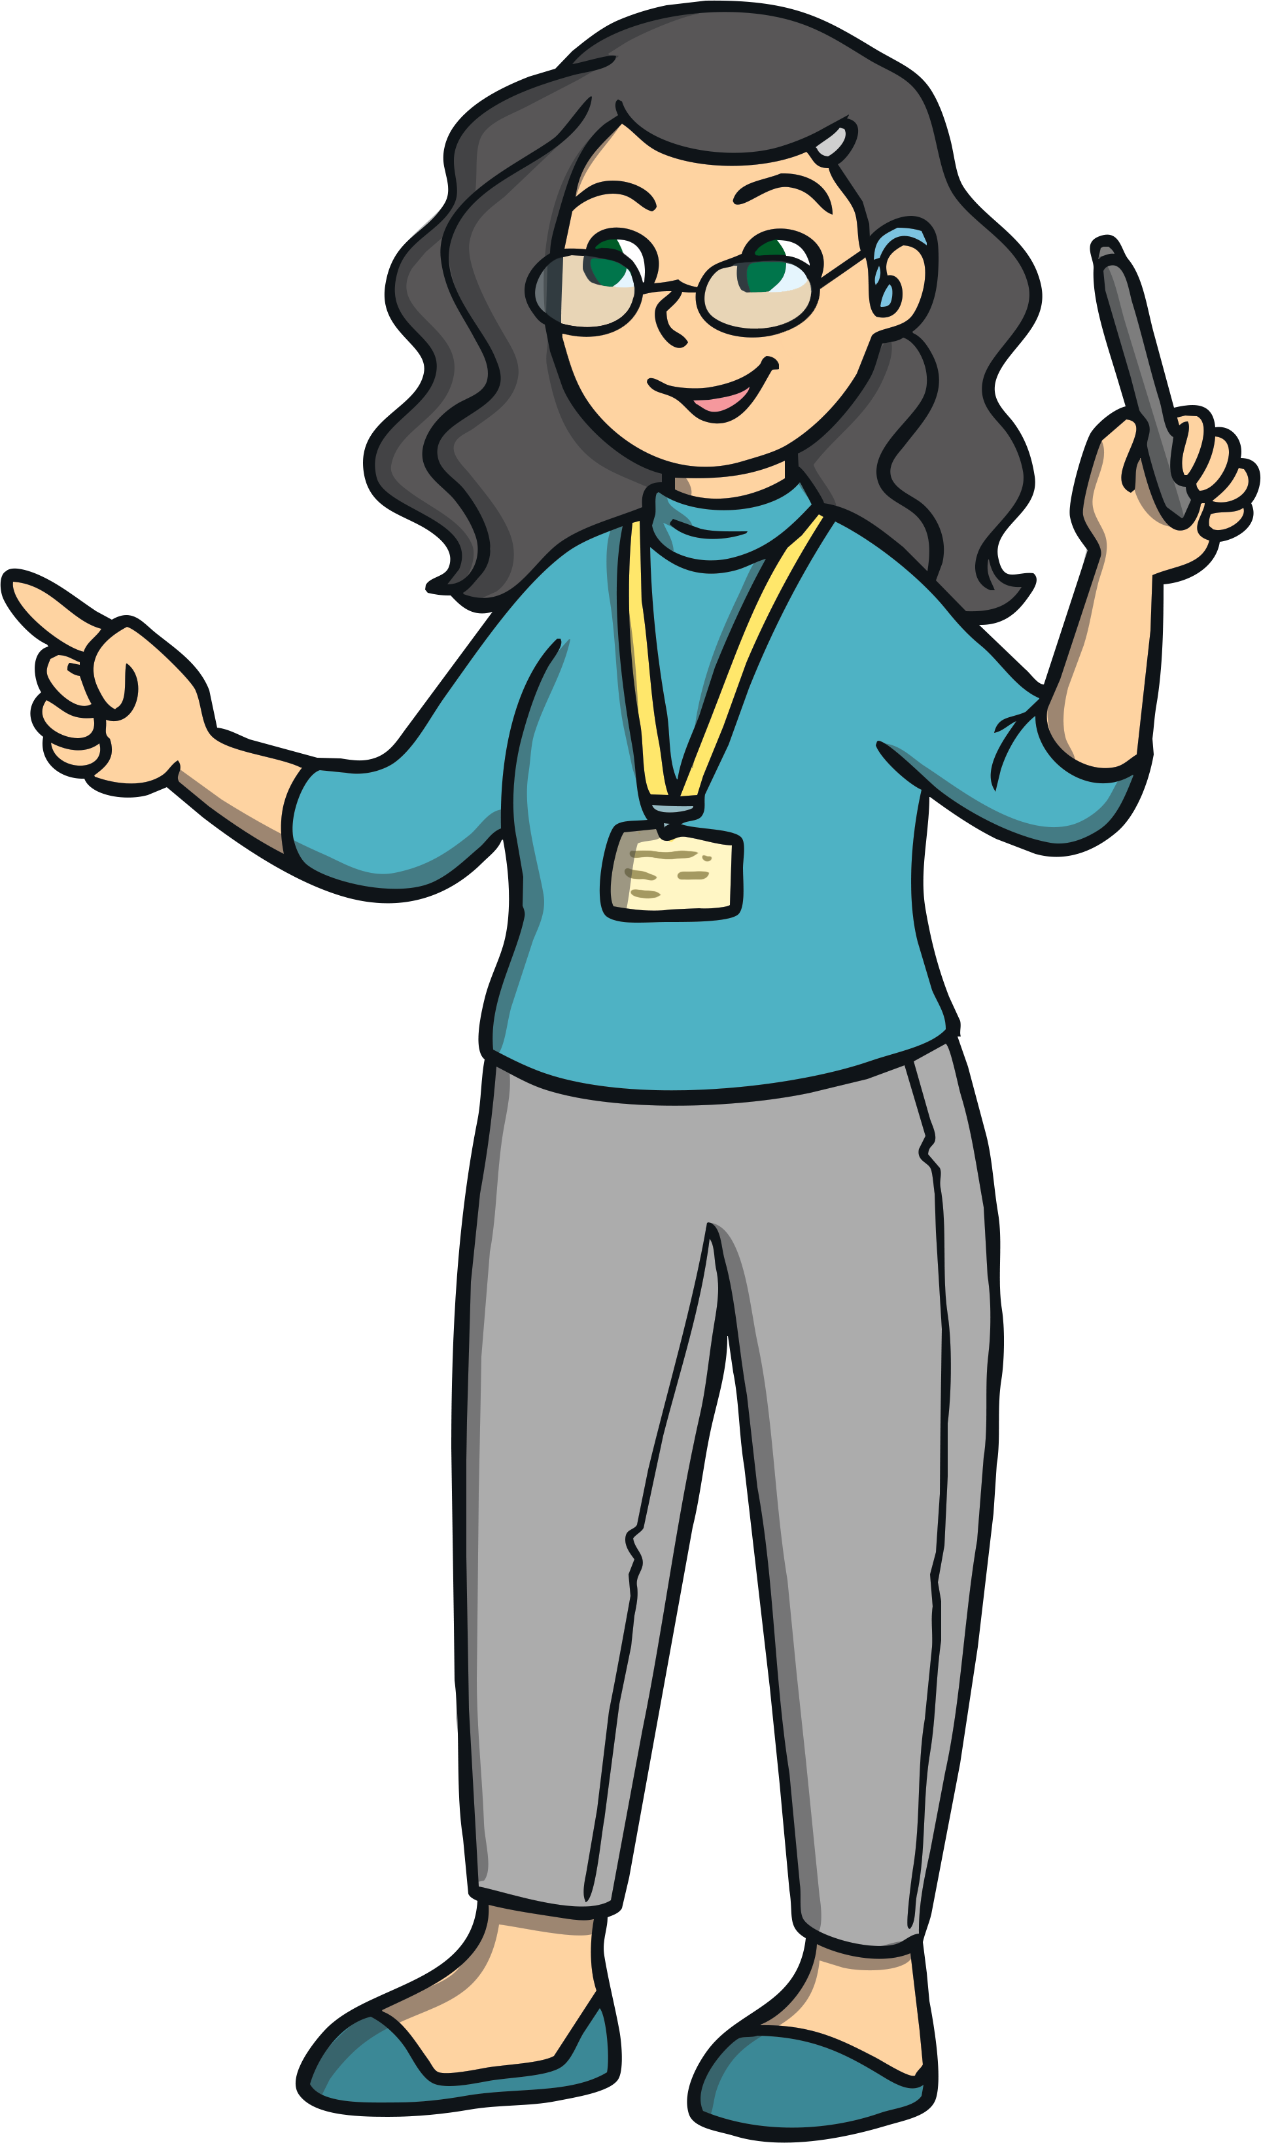
Good Morning everyone and welcome to school today! Let’s see who is here, it’s time to mark the roll.
Vireak
Ellie
Lyheang
Sak Sak
Visal
Bella
Pich
Aurora
Leaksmi
Luna
Jing Su
Bot
Rachna
Nana
Muy Muy
Tek Eang
Lina
En En

Slide 4
Who are this week’s leaders?
Vireak
Ellie
Lyheang
Sak Sak
Visal
Bella
Pich
Aurora
Leaksmi
Luna
Jing Su
Bot
Rachna
Nana
Muy Muy
Tek Eang
Lina
En En

Slide 5
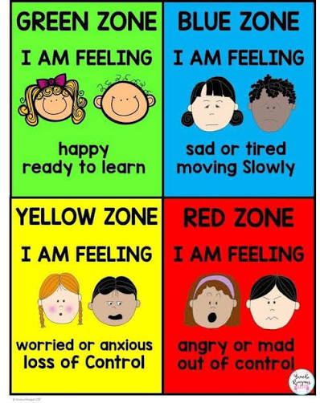
Feelings

Slide 6
How are you feeling today??
Vireak
Ellie
Lyheang
Sak Sak
Visal
Bella
Pich
Aurora
Leaksmi
Luna
Jing Su
Bot
Rachna
Nana
Muy Muy
Tek Eang
Lina
En En

Slide 7
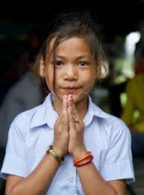
We always start the day with ‘Good Morning Miss Sue’

Slide 8
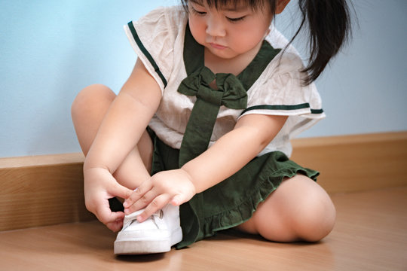
Joeys take off and put on their own shoes

Slide 9
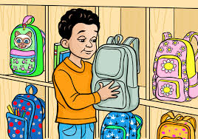
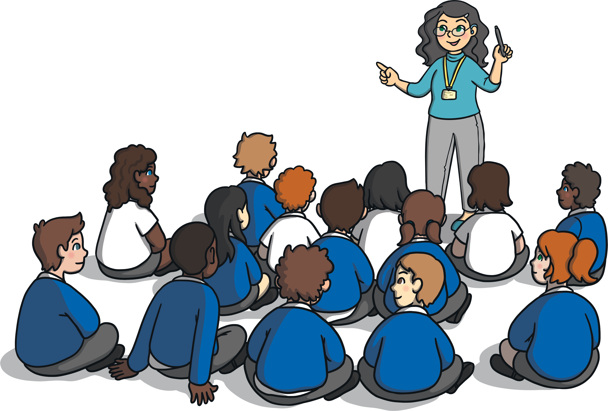
Backpacks, snacks, and water bottle
We put our backpacks in our locker and snacks on the shelf. Water bottles in purple bag.

Slide 10
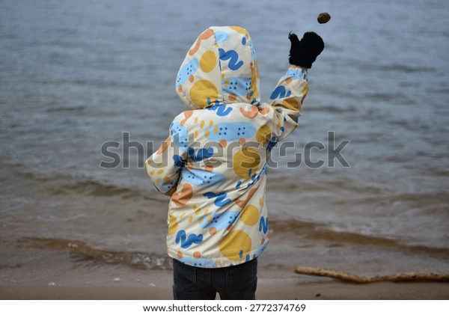
NO THROWING

Slide 11
You will learn the alphabet this week’s letter is n N
n N

Slide 12

You will learn the alphabet this week’s letter is n N

Slide 13
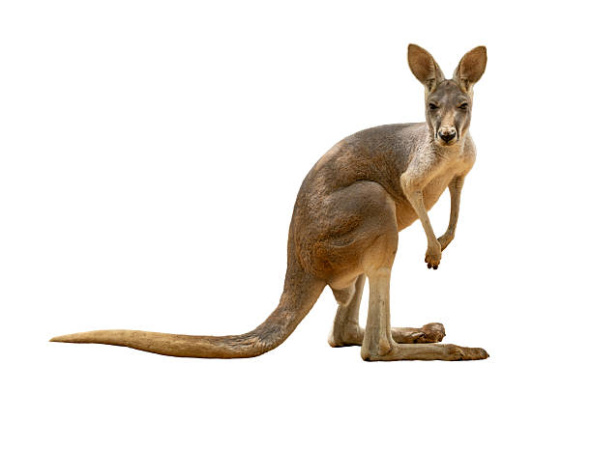
Zero and 1
0 1

Slide 14
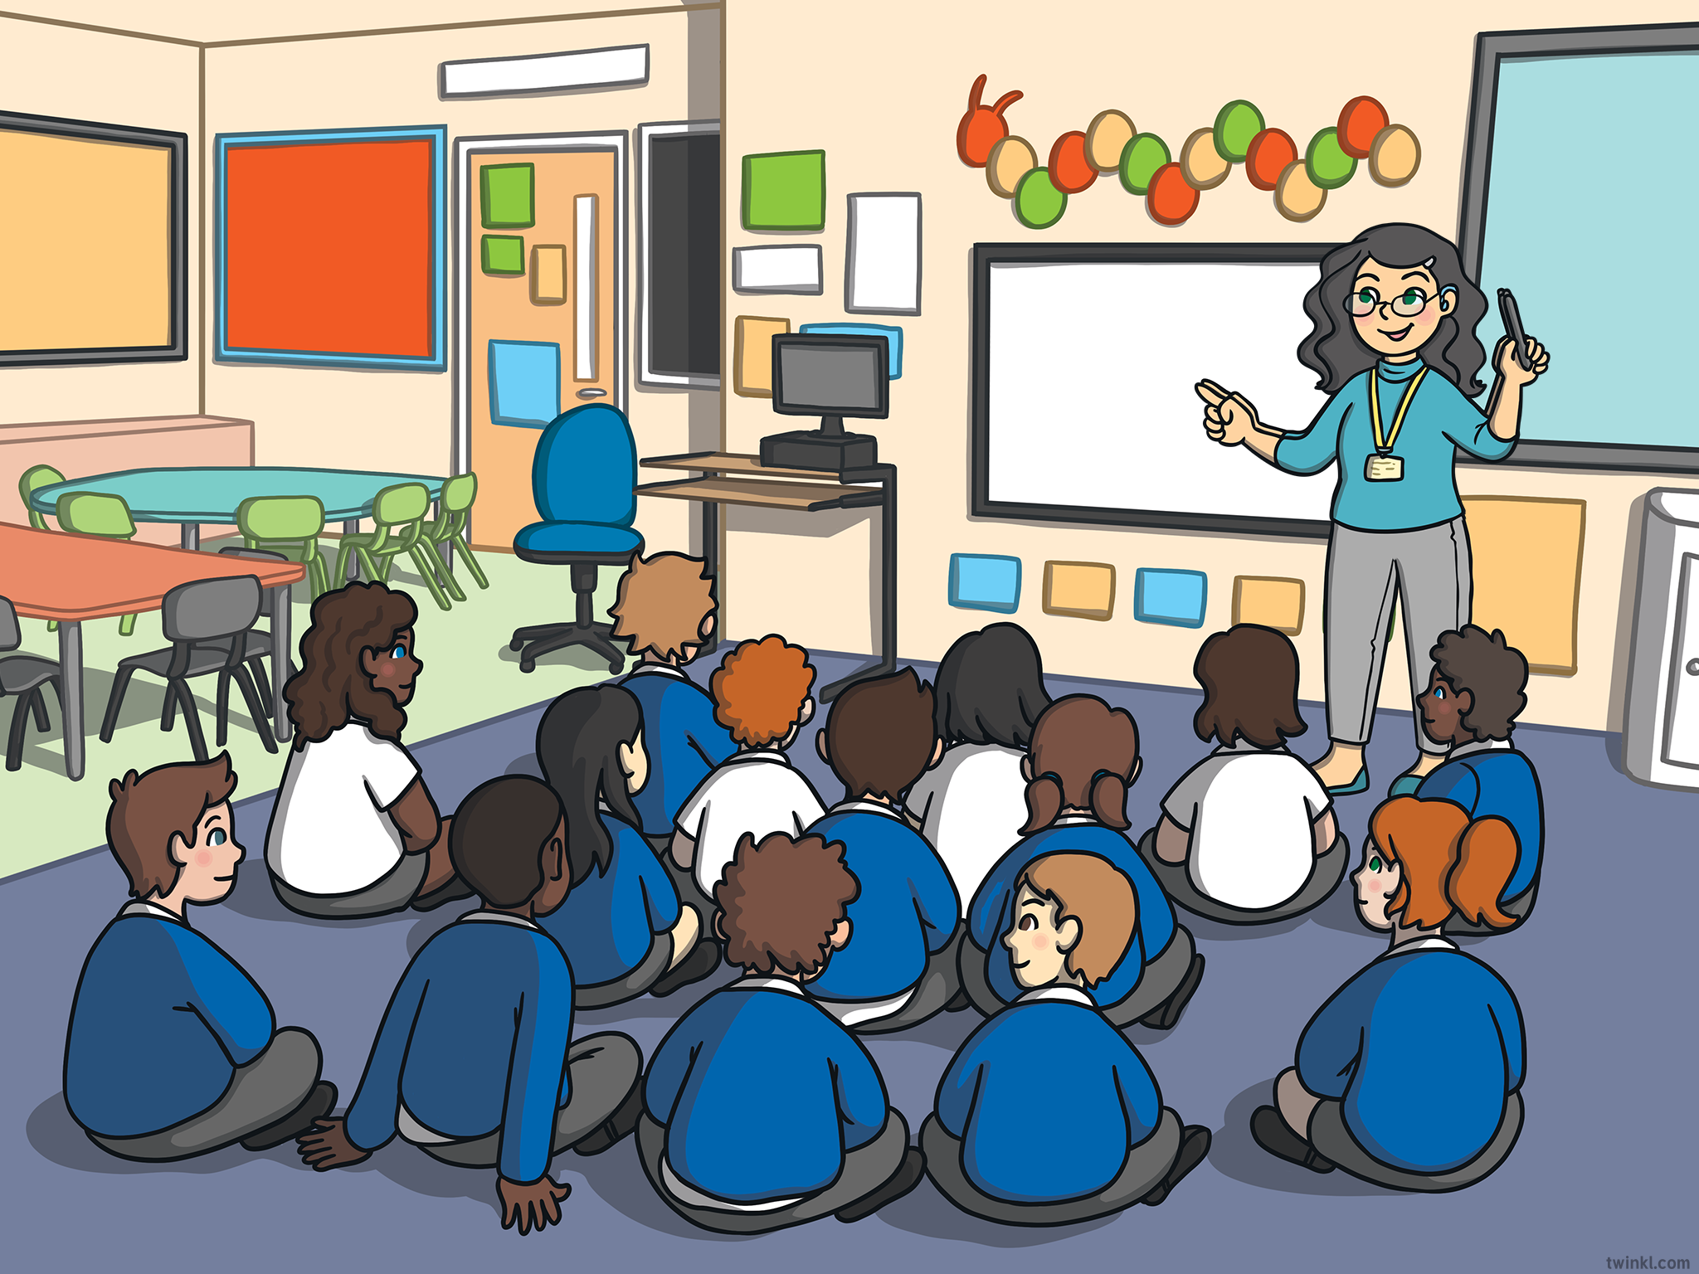
Here are the days of the week. Which day is it?
Monday
Tuesday
Wednesday
Thursday
Friday
Saturday
Sunday

Slide 15
Which MONTH is it?
January
February
March
April
May
June
July
August
September
October
November
December
What DATE is it?

Slide 16

What TIME is it?

Slide 17






What is the weather like today? Can you take a look, and see?
raining
sunny
cloudy
windy
hot
cold
stormy

Slide 18

When we want or need something we say PLEASE

Slide 19
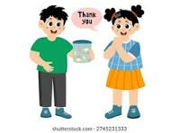
When we get something we say THANK YOU

Slide 20
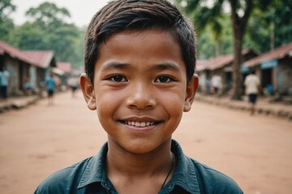
When we give something we say YOU’RE WELCOME

Slide 21
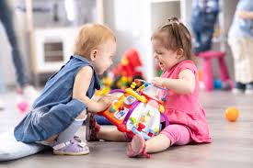
When we play together we……
SHARE OUR TOYS

Slide 22
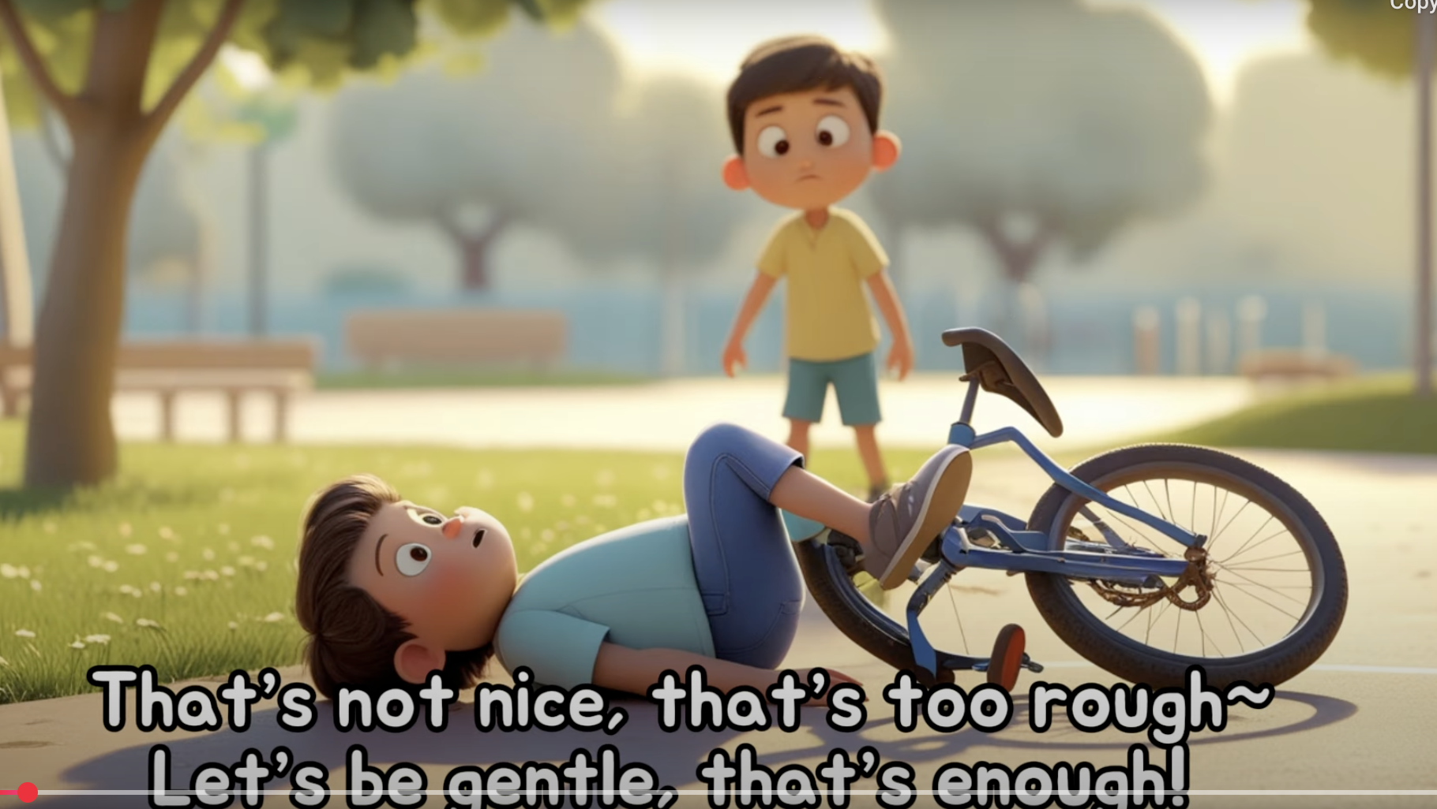
If we don’t like something we say……
STOP IT I DO NOT LIKE IT

Slide 23
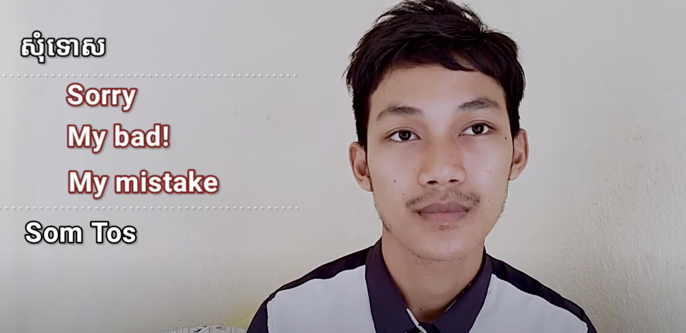
When we make a mistake we say……
SORRY!

Slide 24

When we want someone’s attention, we say EXCUSE ME.

Slide 25
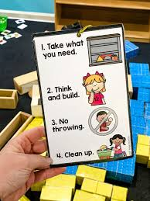
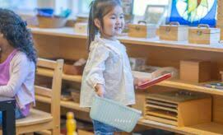
Time to Clean Up! Joeys clean up NOT the Teachers. Clean up on the buzzer, listen for the Clean Up song, and be ready!

Slide 26
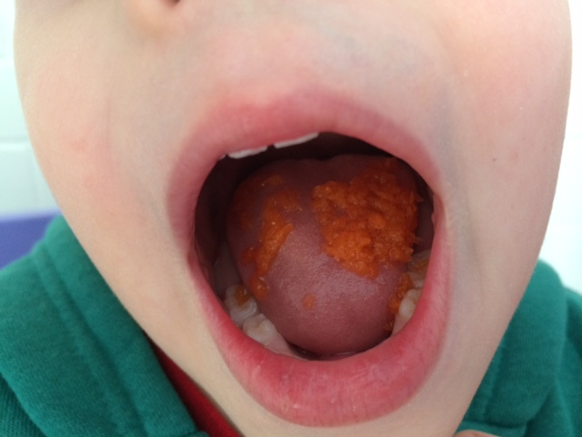
Swallow your food before talking!

Slide 27
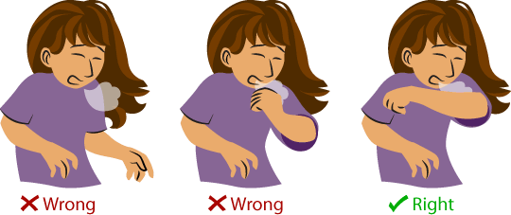
How to cough and sneeze

Slide 28
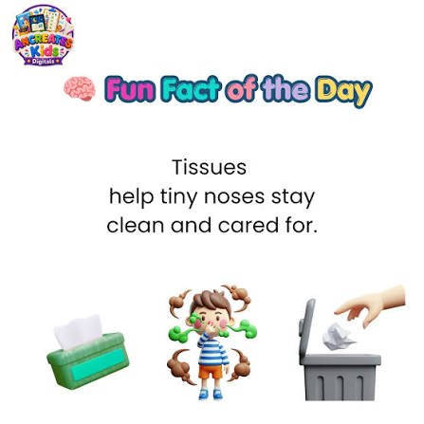
Blow your nose and put the tissue in the trash.

Slide 29
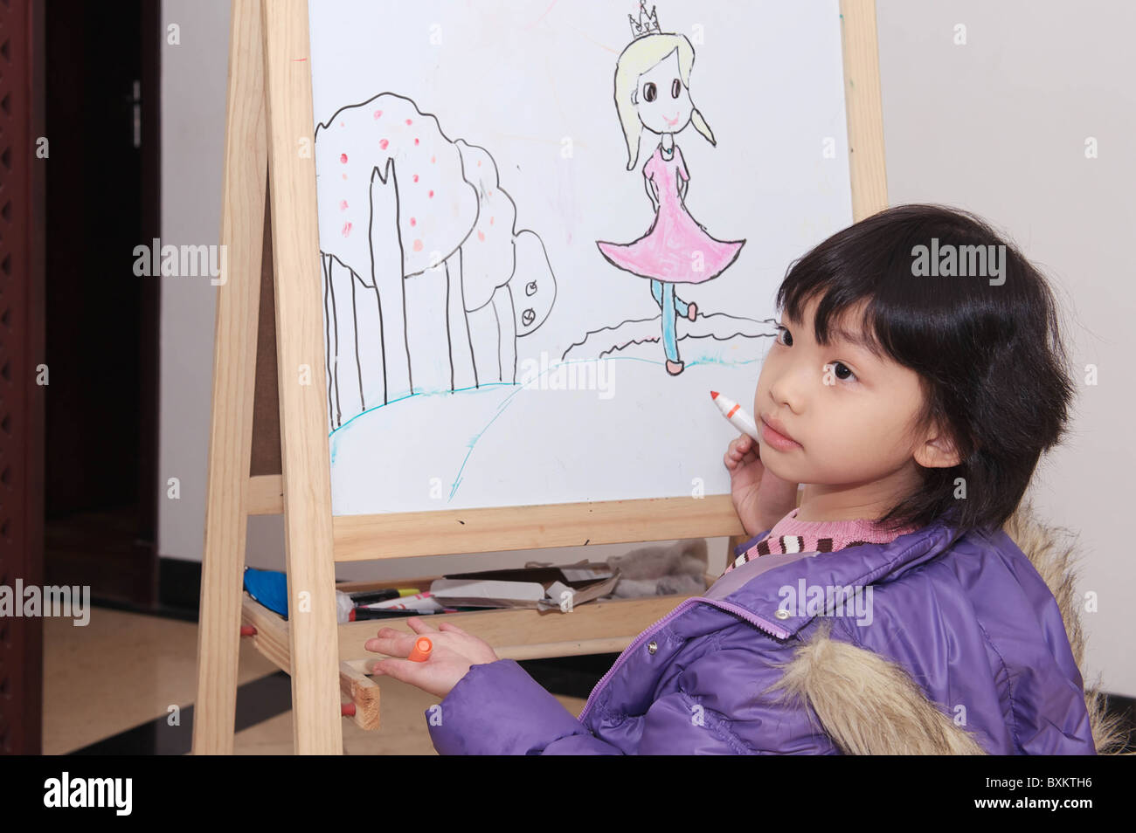
You will learn to draw inside the lines

Slide 30
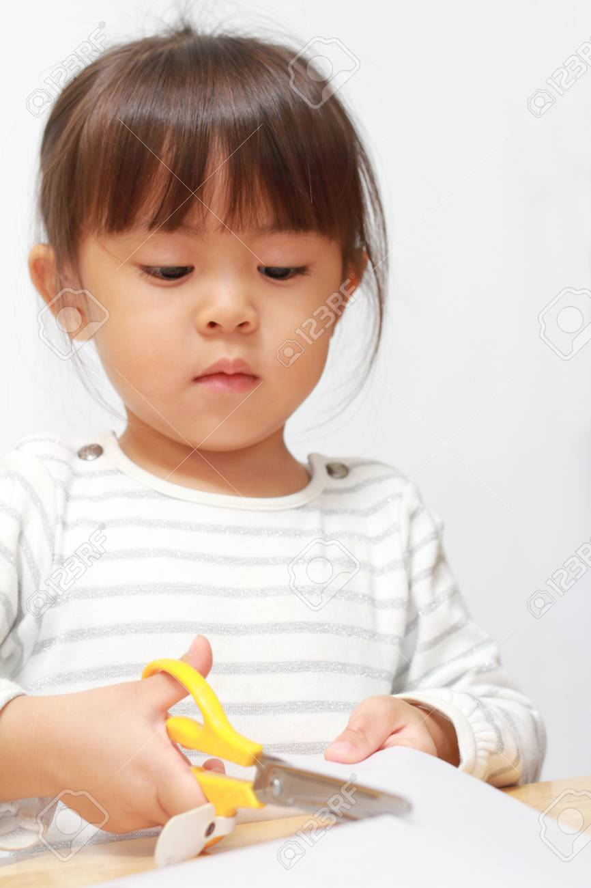
You will learn to use scissors

Slide 31
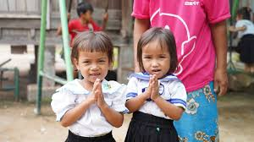
Show respect when someone enters the classroom.

Slide 32
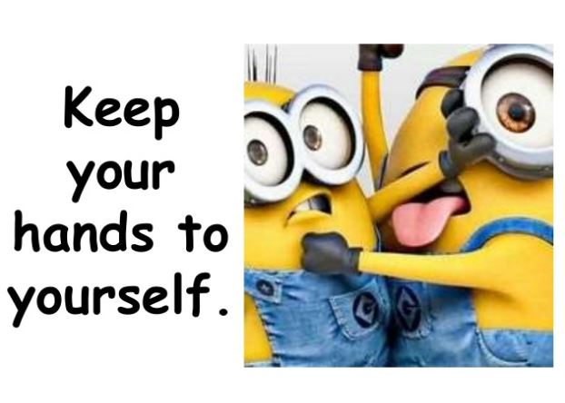
Keep your hands to yourself

Slide 33

Feet are for walking
Heel then toe

Slide 34
We will learn to count

Slide 35
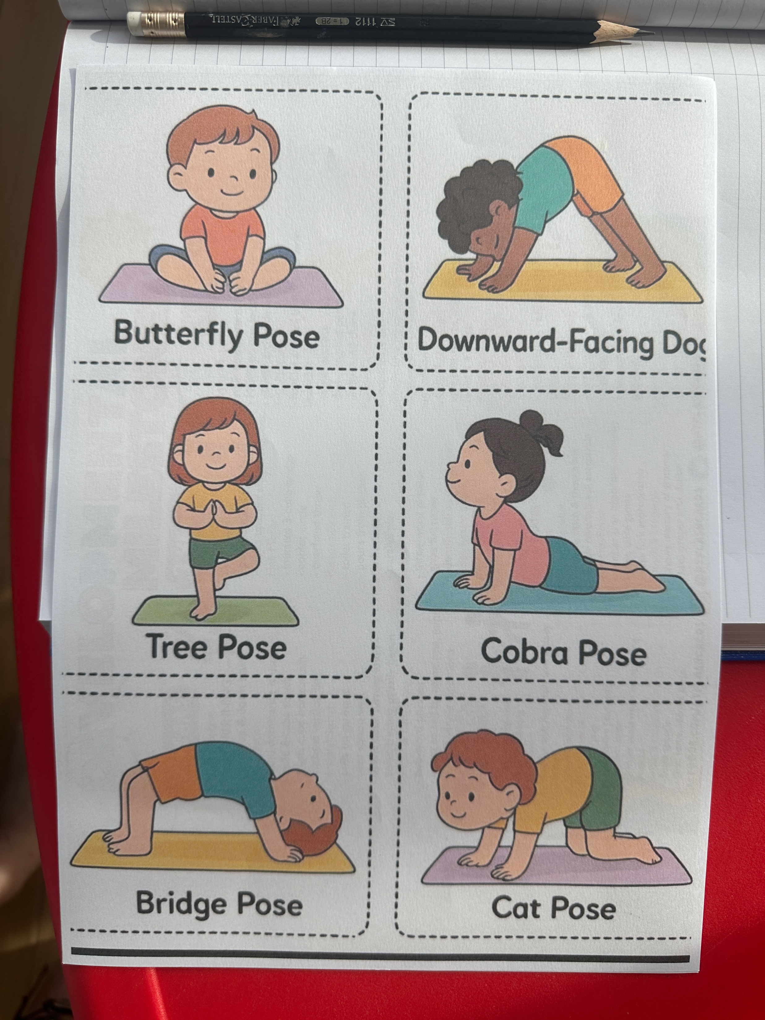
Time for Morning Yoga

Slide 36

HELLO SONG!

Slide 37
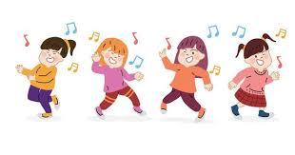
Song Time!

Slide 38

Read a Book

Slide 39

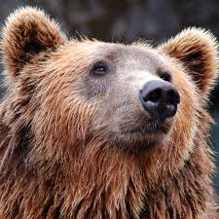


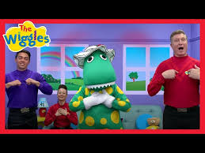
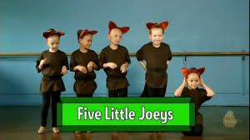
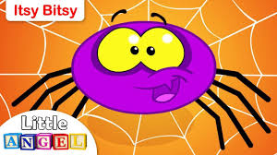
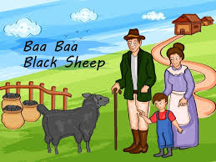

LET’S START OUR DAY!

